Slide 1

I want to break free: challenging the hegemony of traditional composition through improvisation, performance, collaboration and sound installation.
Innovation in Music Conference 2023
Dr. Monica Esslin-Peard
Honorary Fellow
Department of Music
Samuel D Loveless
Freelance composer/performer/sound artist
Innovation in Music Conference ‘23
Edinburgh Napier University
1st July 2023

Slide 2
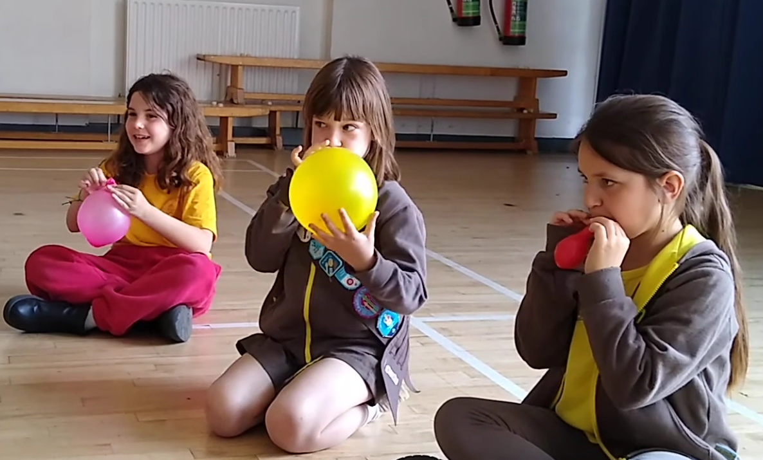
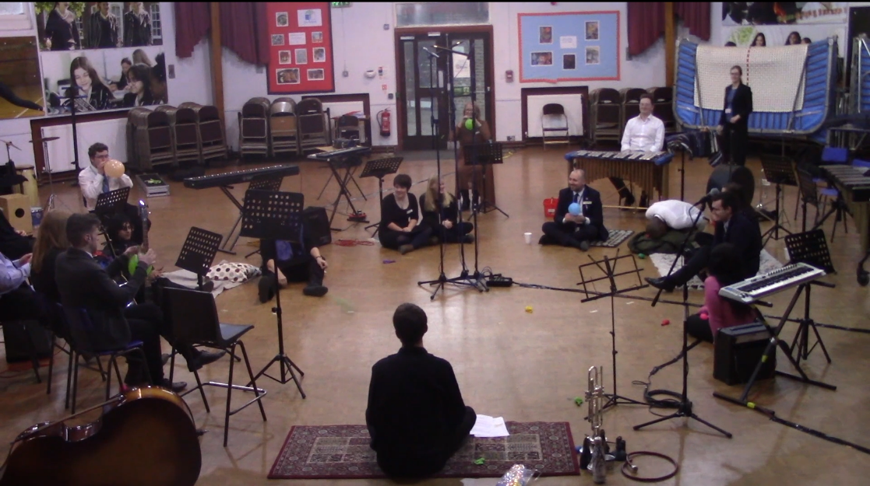

Agenda
Context
Why this study?
Findings from our five sound installation workshops
Discussion and implications for music education in schools and HE and making music in the community
Can we break free?

Slide 3
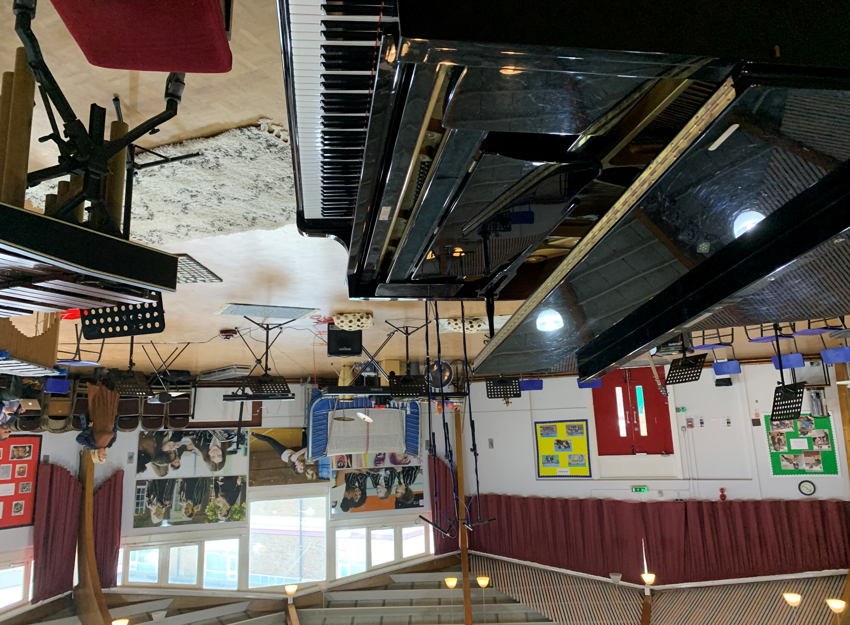
Context
Decline in Music in secondary schools – 50% have no music
Decline in uptake of GCSE and A Level music
So we consider Sound Installation:
‘a performative act which may encompass physical movement, creating sounds with objects, singing and creating sounds with musical instruments and objects focussing on the active involvement of participants, irrespective of their musical backgrounds or abilities’.

Slide 4
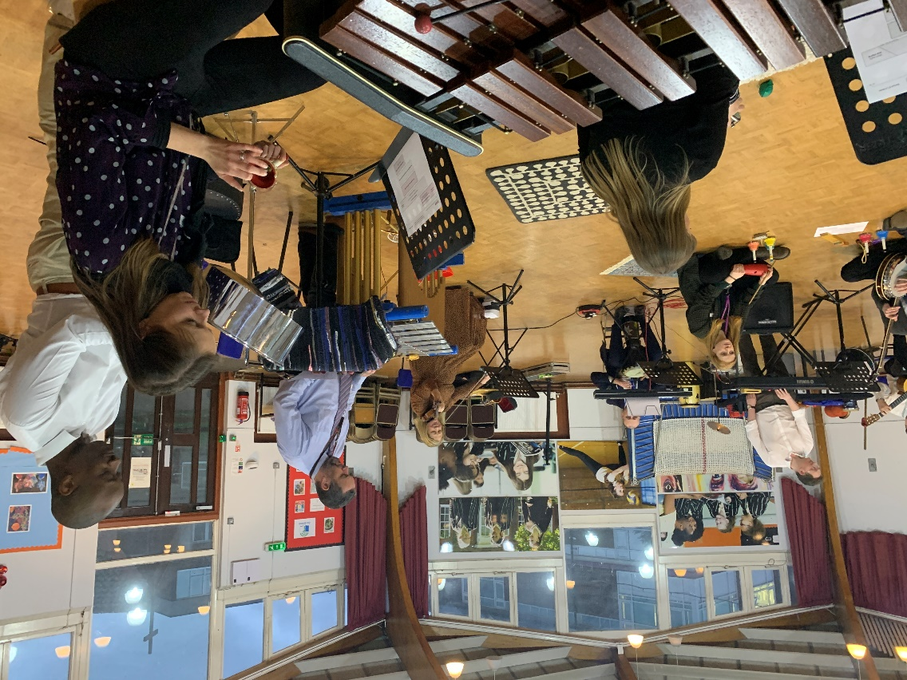
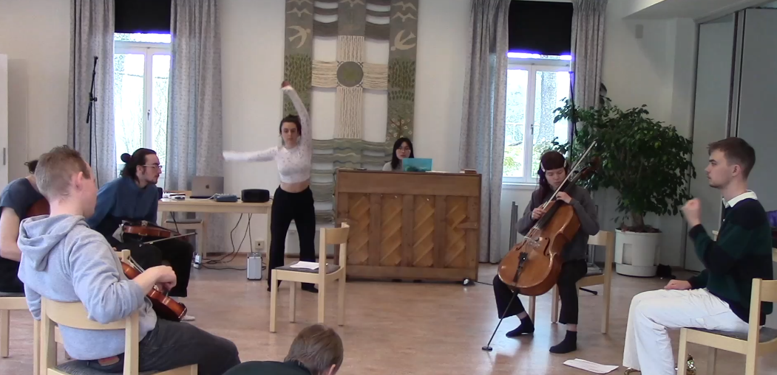
Why this study?
Research Questions
How do musicians participate in four different scenarios in a sound installation?
What implications does an approach based on sound installation have for pedagogy?
How does an inclusive, participatory workshop foster skills development in composition, improvisation and performance?
5 groups in the UK and Sweden
n=77, 33 adults, 44 young people

Slide 5
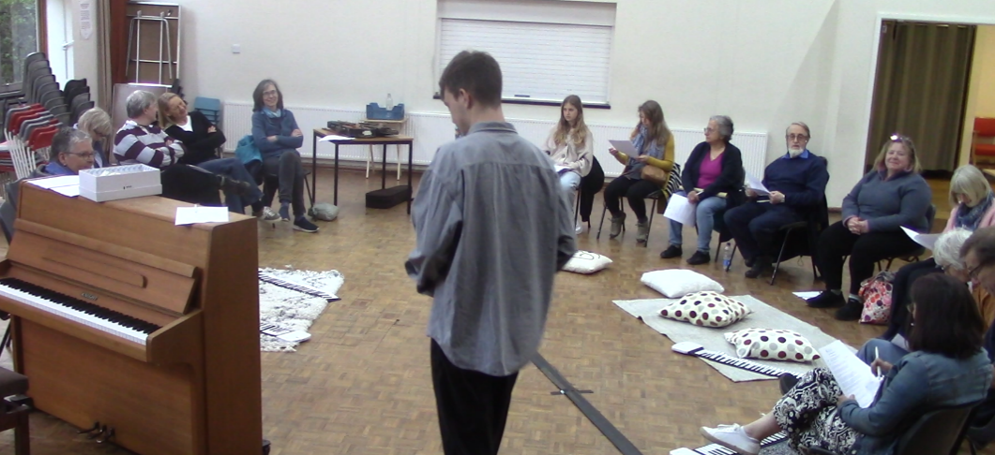
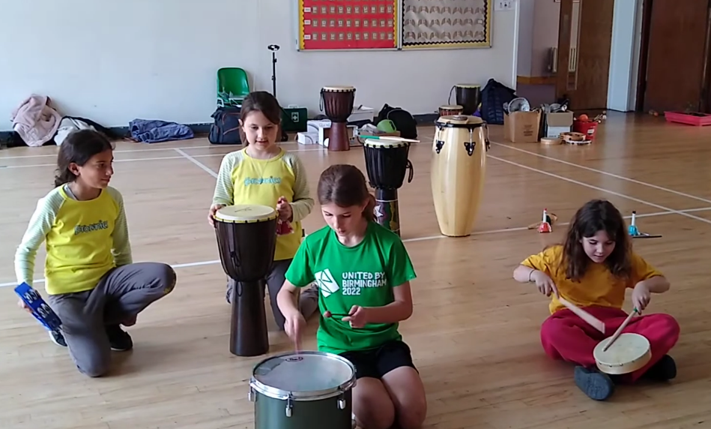
Findings 1 – joy in experimentation
Questionnaire Q1/Q3:
All participants were positive about their experiences.
Notes:
Experimenting with/freedom to create new sounds: over 83% of participants stated this was the most beneficial aspect of the workshops
Over 88% of adult participants stated this was the most beneficial aspect of the workshops
The youngest participants enjoyed experimenting and playing instruments they had not played before

Slide 6
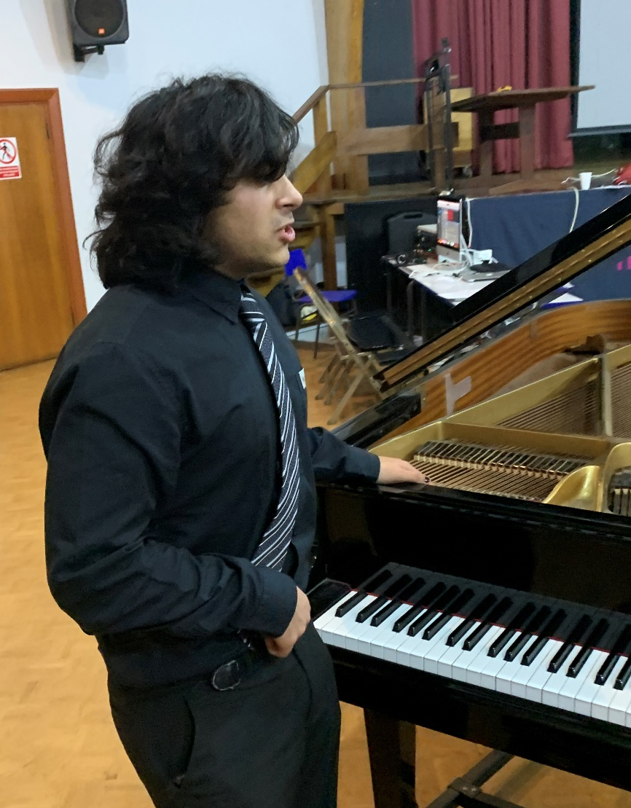
Findings 2 – an understanding/enjoyment away from definitions of ‘making music’
‘Sound is just a part of everyday life. It is there. It doesn’t require a musical structure’
(Strachan, 2017, p. 88)
There was a clear shift in the understanding of what the group could achieve, seeing an increase in enjoyment and engagement as a result, regardless of participants’ prior conceptions of making
Music, (Participant)
Notes:
There was a clear shift in the understanding of what we as a group could achieve, seeing an increase in enjoyment and engagement as a result. Regardless of what the participants consider ‘music’ to be (which I and most people would argue the definition of is outdated).
Note for self: see some of my comments in the spreadsheets as I thought quite a lot about this.

Slide 7
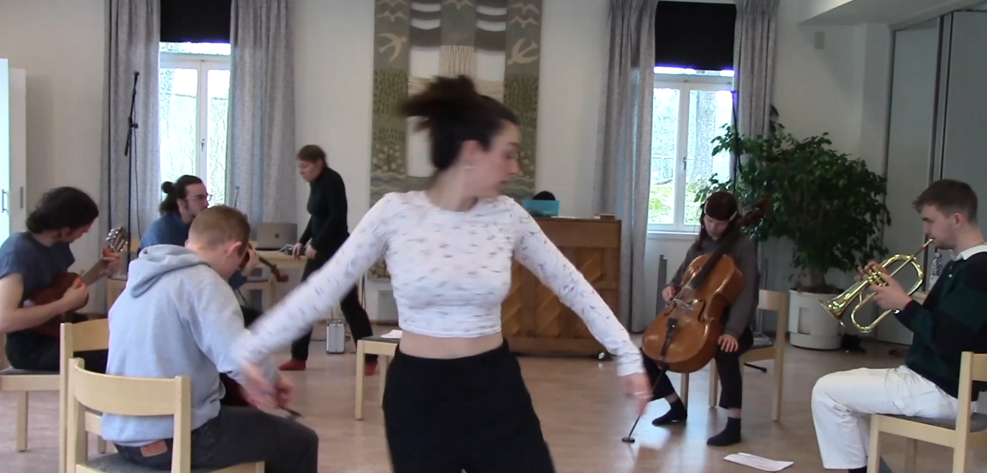
Findings 3 – musical experience is not essential
The participants got out of the workshop what they put into it.
Musical experience was helpful, but not essential.
Swedish UG and PG music students added dance elements to ‘Bloom’.
Amateur singers were most comfortable singing ‘Somewhere’, and decided they would not move around like other groups.
Notes:
Sweden and Brownies were the most successful live.
Sweden and ECS were most successful as recordings.
The Joy of Letting Go was the most successful piece overall.
Whilst musical experience and training does enable you certain affordances, there certainly is a way to effectively engage with this music, despite technical ability. To this end, the technical skill lies with the facilitator (teacher).
Most successful sonic aspects in each workshop initially appeared to be those that aligned closely to the participants’ experience/training. However, this in fact doesn’t seem to be the case.
The most successful experience of the participants in each workshop were where they took ownership and even leadership.
Hounslow teachers: Not applicable
Sweden: All aspects
ECS: Somewhere
Year 9/10: bloom – through exploration of instruments
Brownies: Shuffle, balloons and bloom.
Perhaps then, it is easier to engage/relate to aspects of the workshop that you have some knowledge about. However, I’m happy to boldly state that where this falls down is in confidence, rather than anything else. This can be shown through the comparison of Sweden and Brownies. Mostly, their realisations are VERY close.

Slide 8
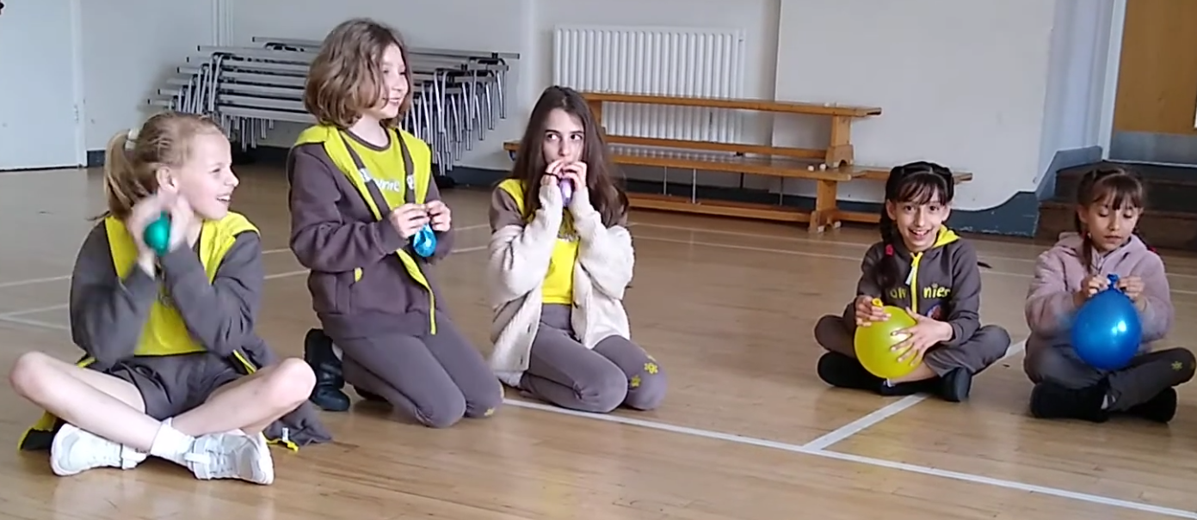
Findings 4 – In what way is this composing?
Participants explored sound and improvisation freely, learning how to create musical sounds and rhythms with balloons.
All groups responded positively to ‘Letting go’.

Slide 9
Findings 5 – each group thought the workshop was relevant to them
‘Very useful in a choir to get everyone to listen to each other. The group today was cooperative and open. What would happen to those who found it silly? Would they open up and listen?’ (Choir member)
‘I would like this in music lessons because theory is boring. I really enjoyed it.’ (Primary school student)
‘This workshop gave me the opportunity to create different sounds through a group setting without any judgement.’ (Swedish music student)
‘Unusual but liberating’ (Music teacher)
‘Thinking outside the box - unusual ways to play an instrument.’ (Secondary school student)
Notes:
When asked where would you like to see these workshops again: each category (adult, student KS3/KS4 and Brownies KS1/KS2) voted for their own situation, i.e. in the local community, in music lessons and extra curricular club respectively.
There is a direct engagement and want for this type of musiking within each group, regardless of age, demographic, experience etc.
This proves ‘Finding 2’.

Slide 10
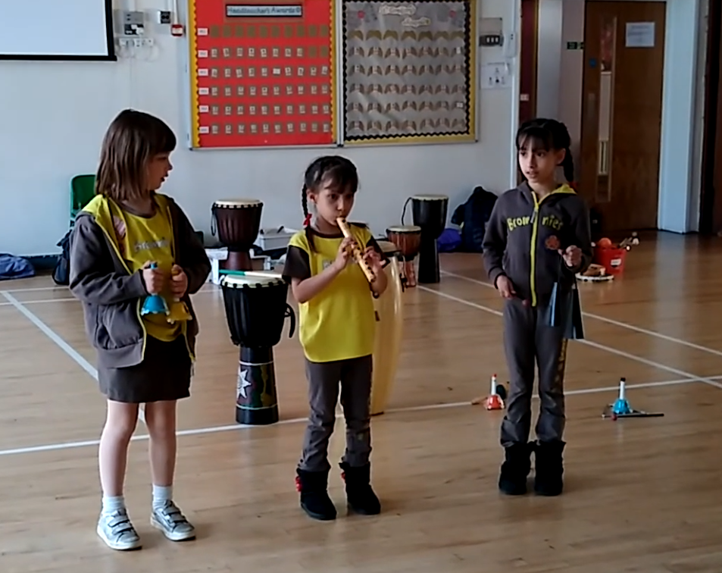
Discussion
Do you need to be a trained musician?
To what extent can you overcome your prejudices if any?
What are the pedagogical benefits? (Listening in a new way, exploration, creativity…)
Making sound without the judgement of others enables participants to compose, improvise and perform with a purpose, i.e. to create music.

Slide 11
Implications or why we should break free
In school music programs today, students may need, desire, and/or benefit from a music education beyond a formal, euro-centric, and/or monocultural experience. Indeed, many likely come to learning with diverse (musical) backgrounds and preferences. Further, music students may find relatable content and processes inviting and enjoyable. (Bennett & Sena Moore, 2023)
Our profession requires a cataclysmic shift from dictating curricula and curriculum content from the 1950s— meaningless to the majority of youth for at least the past 40 years. Our teaching institutions isolate themselves from the realities of 21st century music that are founded upon numerous forms of popular music that have been the core of youth music making and music listening for at least the past 80 years. The ongoing endemic apotheosis of Western classical music and “traditional school music” must cease immediately if music educators are to remain relevant.
(Gouzouasis and Bakan, 2011)

Slide 12
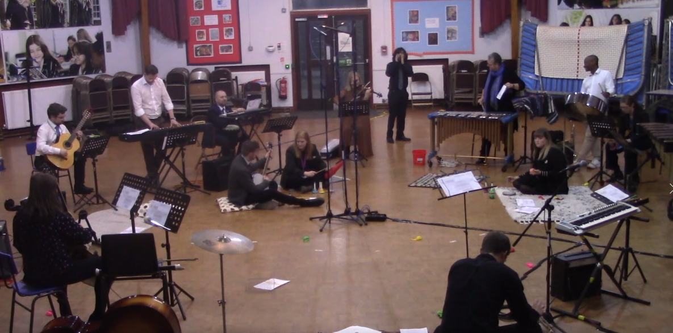
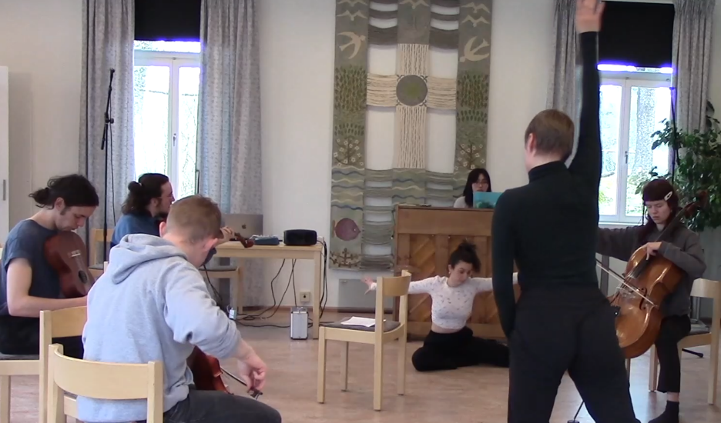
Questions: Can we break free?
Next steps:
More workshops –
a) With neuro-diverse students
in secondary school
b) In conservatoires and
university music
departments
Create and sustain a debate
Contact us to get involved.
Monica.Esslin-Peard@liverpool.ac.uk
SamuelDLoveless@gmail.com

Slide 13
Questions?
Contacts
Dr Monica Esslin-Peard
Email: Monica.Esslin-Peard@liverpool.ac.uk
Samuel D Loveless
Email: SamuelDLoveless@gmail.com

